Slide 1

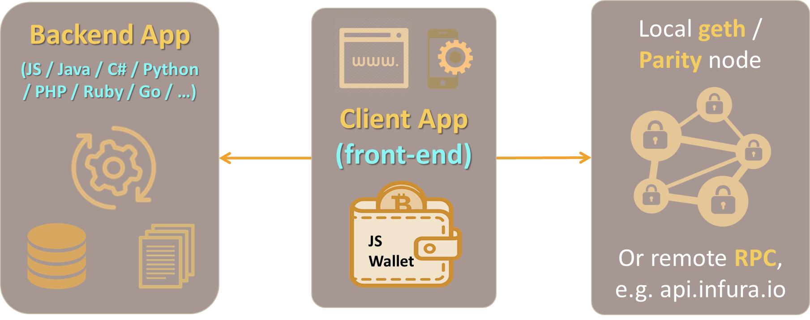
DApps Architectures
DApps: Architectures, Connecting Wallets, The Web3 API, Client-Side and Server Side Interaction with Ethereum
Svetlin Nakov
Senior Technical Trainer
Academy School of Blockchain
http://kingsland.academy

Slide 2

Table of Contents
Architectures for Decentralized Apps on Ethereum
Server-Side Interaction with the Blockchain (Server Wallet)
Client-Side Interaction with the Blockchain (JS Wallet)
Client-Side Interaction through MetaMask
Multi-Signature Interaction with the Blockchain

Slide 3
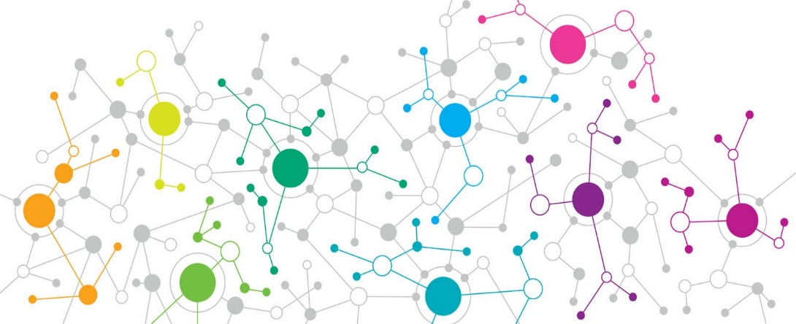
Decentralized Blockchain Apps (DApps)
DApps
DApps hold backend code and data on the blockchain
The front-end is still a traditional app
Client App (front-end)
HTTP
Traditional Backend Server-side code + data
RPC
RPC
Smart Contract Backend Code + data on the blockchain

Slide 4
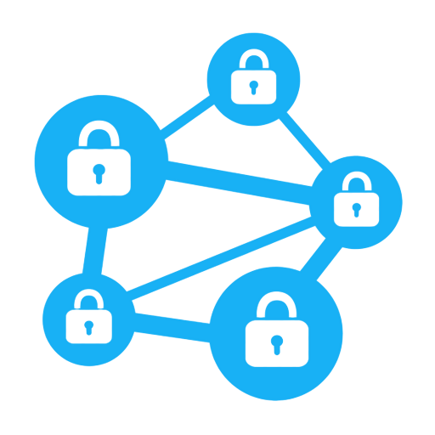
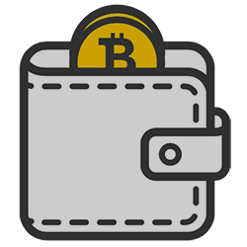


Server-Side Interaction with the Blockchain
Local geth / Parity node
Backend App
(JS / Java / C# / Python / PHP / Ruby / Go / …)
Client App (front-end)
HTTP
RPC
Server Wallet
Or remote RPC, e.g. api.infura.io
Note: the server-side wallet signs all transactions → it might be subject to hard hacker attacks → don't keep large amounts in it!

Slide 5
Sample Scenario for Server-Side Interaction
Document Registry DApp
Goal: keep a set of authentic documents on the blockchain
Users can view / verify documents, published on the blockchain
PDF documents hosted in IPFS (decentralized storage)
Document hashes published in a smart contract
Admins can upload new documents
Blockchain transactions are signed at the server-side
Encrypted server-side wallet, unlocked by admin's password

Slide 6

Web3 API: Connecting to Ethereum
Web3 API (for JavaScript)
https://github.com/ethereum/wiki/wiki/JavaScript-API
Nethereum (for C#)
https://github.com/Nethereum/Nethereum
Web3J (for Java)
https://github.com/web3j/web3j
web3.py (for Python)
https://github.com/ethereum/web3.py

Slide 7

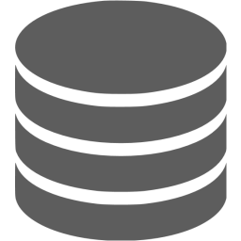

Client-Side Interaction with the Blockchain
Backend App
(JS / Java / C# / Python / PHP / Ruby / Go / …)
Client App (front-end)
geth / Parity node
at the server-side
HTTP
RPC
JS Wallet
Or remote RPC, e.g. api.infura.io
Using a client-side JS wallet (e.g. LightWallet) simplifies the interaction and delegates the security risks to the end-users

Slide 8
Client-Side JS Wallet
User registers in a mobile app / Web app
A client-side wallet is created during the registration
The wallet JSON is stored in the app / browser's LocalStorage
Strong encryption (Scrypt), based on strong password
Optionally the wallet JSON can be stored at the server-side or in Dropbox / Storj (readable by key-derived from the password)
Security assumptions:
The user's password and private key never leave the client app!
All transactions are signed client-side, never at the server-side!

Slide 9
Sample Scenario for Client-Side JS Wallet
Crypto Travel Service
Users register in the system and get a wallet (private key + address)
The wallet JSON is stored client-side, strongly encrypted (users can backup it in case of damaged / lost device)
The wallet password / private key never leave the client app
Transport providers also register and get a wallet
Request payments via QR code, e.g. inside the bus / train / taxi
Users pay for transport service using a mobile app (via the QR code)
Transfer the requested ETH to the payment contract
Transport providers get their ETH from the contract upon request

Slide 10
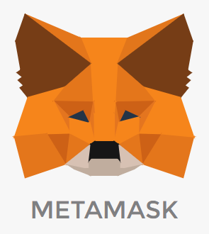
Client-Side Interaction through MetaMask
Backend App
(JS / Java / C# / Python / PHP / Ruby / Go / …)
Client App (front-end)
geth / Parity node
at the server-side
HTTP
JS Wallet
RPC
Or remote RPC, e.g. api.infura.io
Use MetaMask to protect private keys and sign transactions client-side
MetaMask is currently unavailable on mobile devices!

Slide 11
Sample Scenario for MetaMask Interaction
The CryptoKitties Game
Goal: view, purchase, breed and sell collectable items (kitties)
https://www.cryptokitties.co
Site visitors can browse the kitties, published on the blockchain
Server-side logic reads the kitties from the blockchain
Registered users can purchase / sell kitties
MetaMask is used to sign transactions / interact with smart contracts
MetaMask addon provides "Injected Web3 API" inside the browser

Slide 12
Multi-Signature Interaction with the Blockchain
Client App (front-end)
Backend App
(JS / Java / C# / Python / PHP / Ruby / Go / …)
Local geth / Parity node
HTTP
Submit
payouts
Send
ETH
Send confirmed payout
Multi-Sig Wallet
Or remote RPC, e.g. api.infura.io
RPC
Confirm
Confirm
Verifier
Verifier

Slide 13
Multi-Signature Interaction with the Blockchain
For increased security multi-signature wallets can be used
A multi-signature Ethereum wallet is a special smart-contract
Example: https://github.com/gnosis/MultiSigWallet
Functionality of multi-signature wallets
Configure wallet owners + number of signatures
Submit a new transaction { address + value + data } → id
Confirm / revoke transaction by id
Execute transaction by id (after confirmed by enough owners)

Slide 14
Sample Scenario for Multi-Signature
Crypto Marketplace
Sellers put some items for sale
Users pay to the marketplace multi-sig wallet address
Users confirm the purchased items were delivered
Then the marketplace adds a payout transaction:
multi-sig wallet address → seller address
On a daily basis another persons confirm the waiting transactions
Finally, one person sends the confirmed transactions for the day

Slide 15
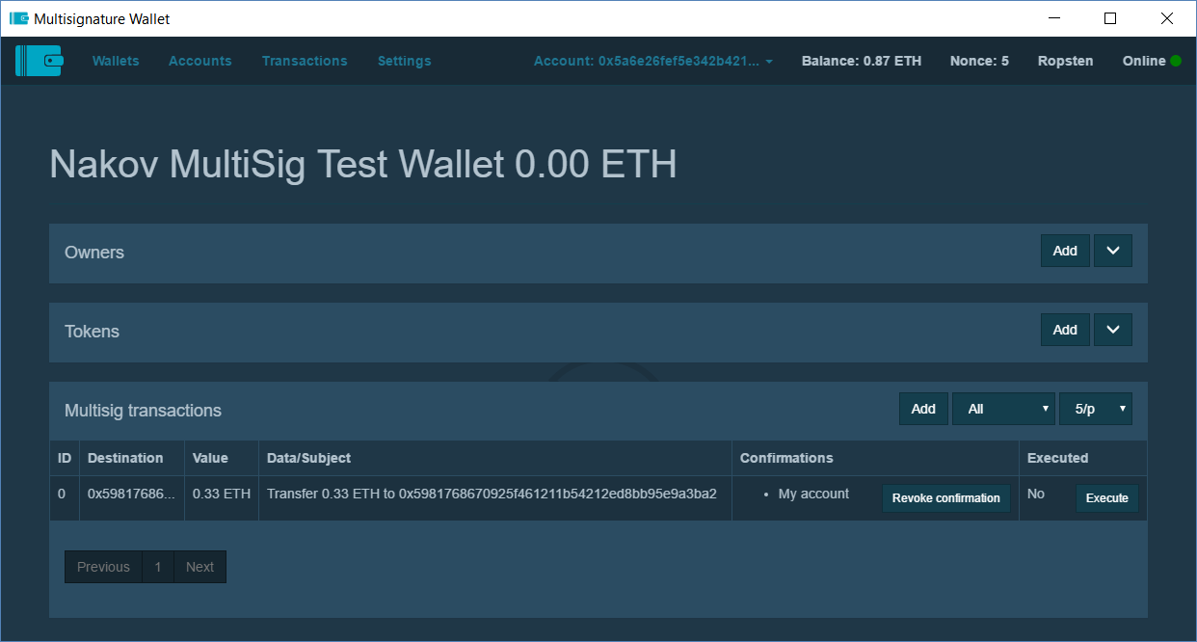
Multi-Signature Wallet
https://wallet-website.gnosis.pm

Slide 16

Summary
Decentralized apps on the Ethereum blockchain may implement
Server-side interaction with the blockchain (server wallet)
Client-side interaction with the blockchain (JS wallet)
Client-side interaction with the blockchain through MetaMask
Multi-signature interaction with the blockchain through a multi-sig wallet contract

Slide 17
DApps Architectures
http://www.kingsland.academy

